Slide 1
Part 2
CARING FOR COUNTRY WITH
CULTURAL BURNING

Slide 2

What do we know about
Aboriginal Cultural Burning?
Notes:
Ask the students if they have ever heard of ‘Aboriginal Cultural Burning’. Facilitate a short discussion about what they already know. Record key points on the board.

Slide 3
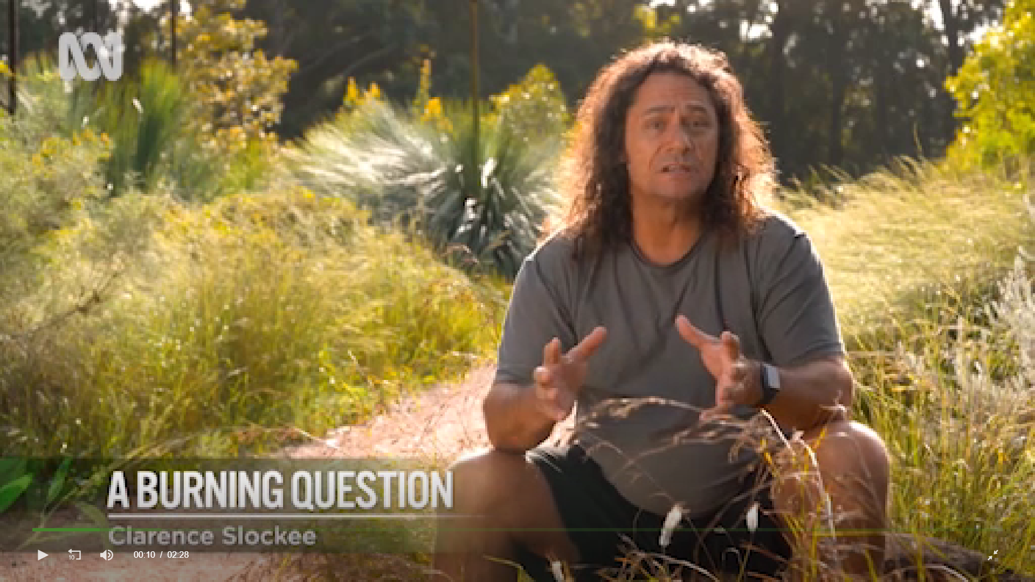
What burning question do you have?
What is the most important point?
What is something you found interesting?
What is something you found difficult to understand?
What burning questions do you have?
Link to video
https://www.abc.net.au/gardening/factsheets/a-burning-question-fire/12395700
Notes:
Provide each student a blank piece of A4 paper. Show them how to fold it into quarters. Instruct them to copy down the questions as shown on the slide.
Tell the students they are going to watch a short video about Aboriginal Cultural Burning and after the video they will respond to the questions on their sheet of paper.
Play the video ‘A Burning Question’. NB: The video cannot be embedded in the slide. Access the video here https://www.abc.net.au/gardening/factsheets/a-burning-question-fire/12395700
Think – Pair- Share: After the video, give the students a few minutes to write their responses to each question. When finished, they can share their responses with the person next to them. Encourage the students to listen actively to each other by tell them that when they have completed their conversations, you will ask some students to explain their partner’s thinking.
Go around the class asking students to share one of the responses from their partner. Encourage the students to listen for similarities and differences to their own responses.
Students can then paste their sheet into their learning journal or write a short reflection on the video using the questions as prompts.

Slide 4
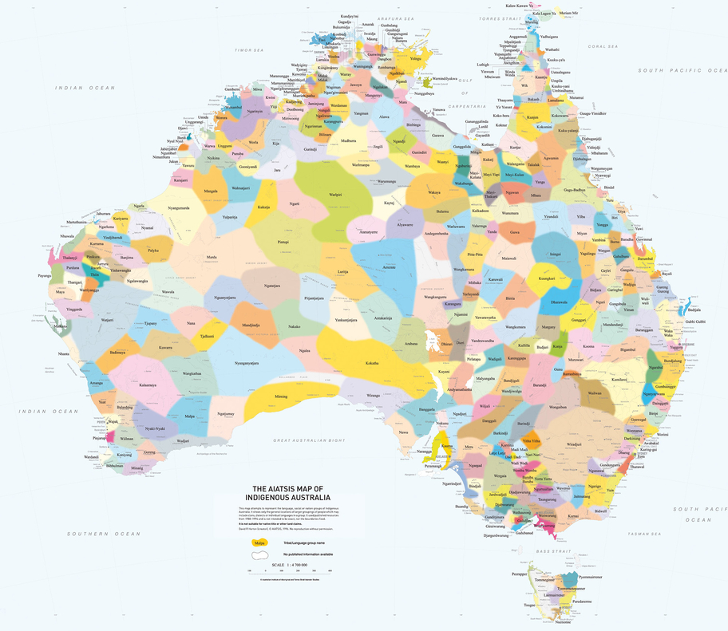
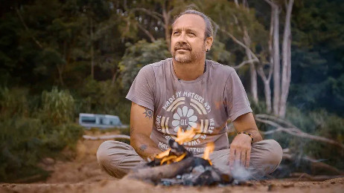


Field Notes - Aboriginal Cultural Burning on
Kuku-Yalanji Country
Notes:
Organise the students into groups of 3 or 4. Tell the students, this will be their ‘research team’.
Tell the students: “You are going on a virtual field trip to Kuku-Yalanji Country in far north Queensland where you will meet Aboriginal cultural burning expert, Victor Steffensen. There are three research questions you need to find answers to on this field trip. You will record the answers in your field notes. NB: The research questions are on the next slide.
Tell the students to open a new page of their learning journal and write the heading ‘Field notes - Aboriginal Cultural Burning on Kuku-Yalanji Country’

Slide 5
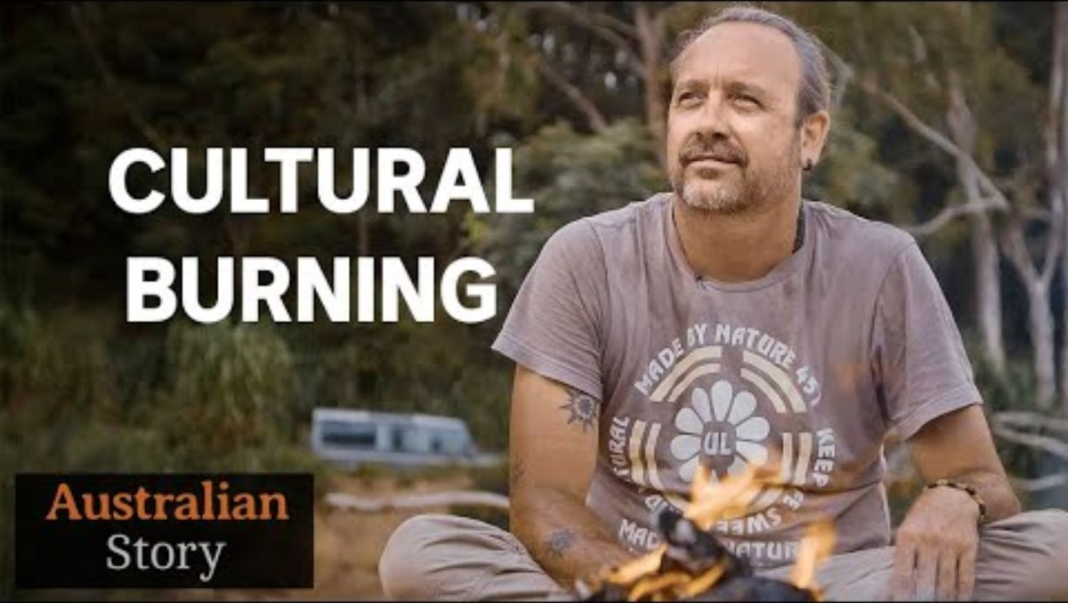
Notes:
Link to video https://www.youtube.com/watch?v=d-9hmEiH828&embeds_referring_euri=https%3A%2F%2Fhubblecontent.osi.office.net%2F&source_ve_path=Mjg2NjY
Play the video in three parts. Before playing each part, write the corresponding research question on the board and ask the students to write it into their learning journal. Tell the students that at the end of each part they will have the chance to discuss their field notes with the other members of their research team and add in anything they might have missed. NB: Advise students that they can record their field notes using both text and drawings.
Part 1: 0:00 - 09.57 Question: How did Victor learn about Cultural Burning?
Part 2: 09.57 - 20:17 Question: Why do Aboriginal people burn Country?
Part 3: 20:17 – Question: What is Victor hoping to achieve?
At the end of the video, invite each research team to share their answers to each research question with the class.

Slide 6
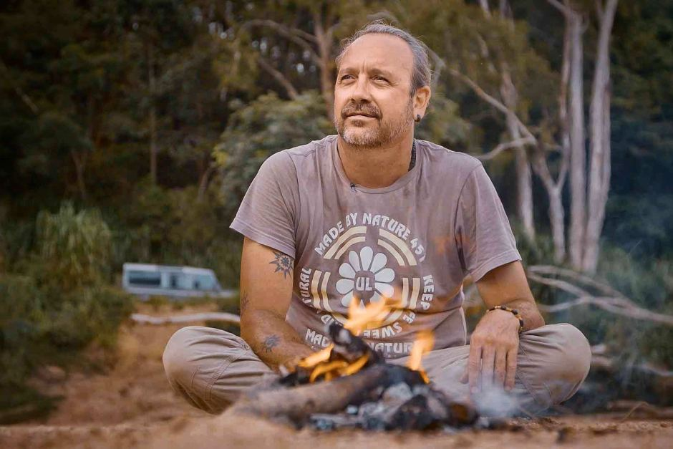
Curious questions
An important skill for any researcher is being able to ask good open-ended questions.
If you had the chance to interview Victor, what questions would you ask him?
Brainstorm open-ended questions for Victor in your research teams.
Write down your top 5 questions in your learning journal.
WHO
WHAT
WHERE
WHEN
WHY
HOW
Notes:
Facilitate a short discussion about the difference between closed and open-ended questions. NB: Closed-ended questions can be answered with yes or no (e.g. Is cultural burning beneficial for plants and animals?). Open-ended questions cannot be answered with a yes or no and require the respondent to elaborate on their points (e.g. What are the benefits of cultural burning for plants and animals?). Open-ended questions usually start with who, what, where, when, why or how.
With the students still in their research teams, allow a few minutes for them to brainstorm open-ended questions for Victor. They can use their field notes for inspiration and record their questions on a large piece of paper. Explicitly instruct the students to be respectful and think carefully about whether Victor would be comfortable answering each question.
Students can then individually select their own top 5 questions from their group list and record them in their learning journals.

